Slide 1
Introduction
Digital logic is fundamental in creating electronic devices.
Electronic circuits are basis of developing Very large scale integration(VLSI)
VLSI is basis for all day today computational frameworks
Pure software computation may not work with all smart devices existing today
So software engineers should have basic knowledge of logic devices and its working without doubt

Slide 2
In parallel you will realize all that components studied in theory in their lab sessions and will practice to develop applications based on it
Logic design will help to study some core subjects like computer architecture in future while designing processors
Further you may apply this architecture subject to enhance and study parallel programming.
After going through the series of theory and lab contents you will be able to make mini projects on logic circuits and you can connect your circuits and realize through software

Slide 3
Truth Table

Slide 4
Logic Gates & Network
AND Gate

Slide 5
Logic Gates & Network
NOT Gate
OR Gate

Slide 6
Logic circuit

Slide 7
Analysis of a logic network
Analysis process: For an existing logic network, it must be possible to determine the function performed by the network.
Synthesis process: The reverse task of designing a new network that implements a desired functional behavior.

Slide 8
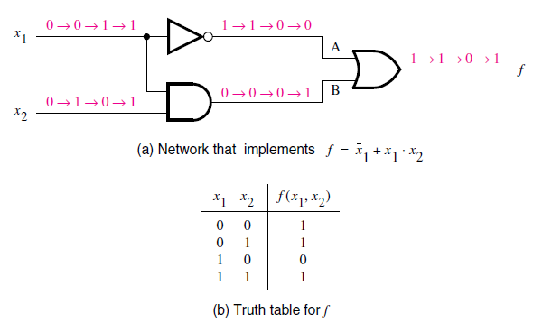
Example of logic networks

Slide 9
Timing Diagram

Slide 10
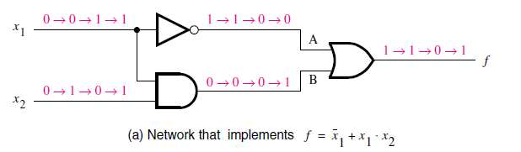
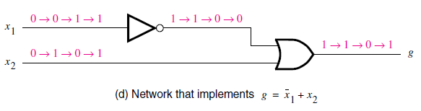
Functionally Equivalent Network

Slide 11
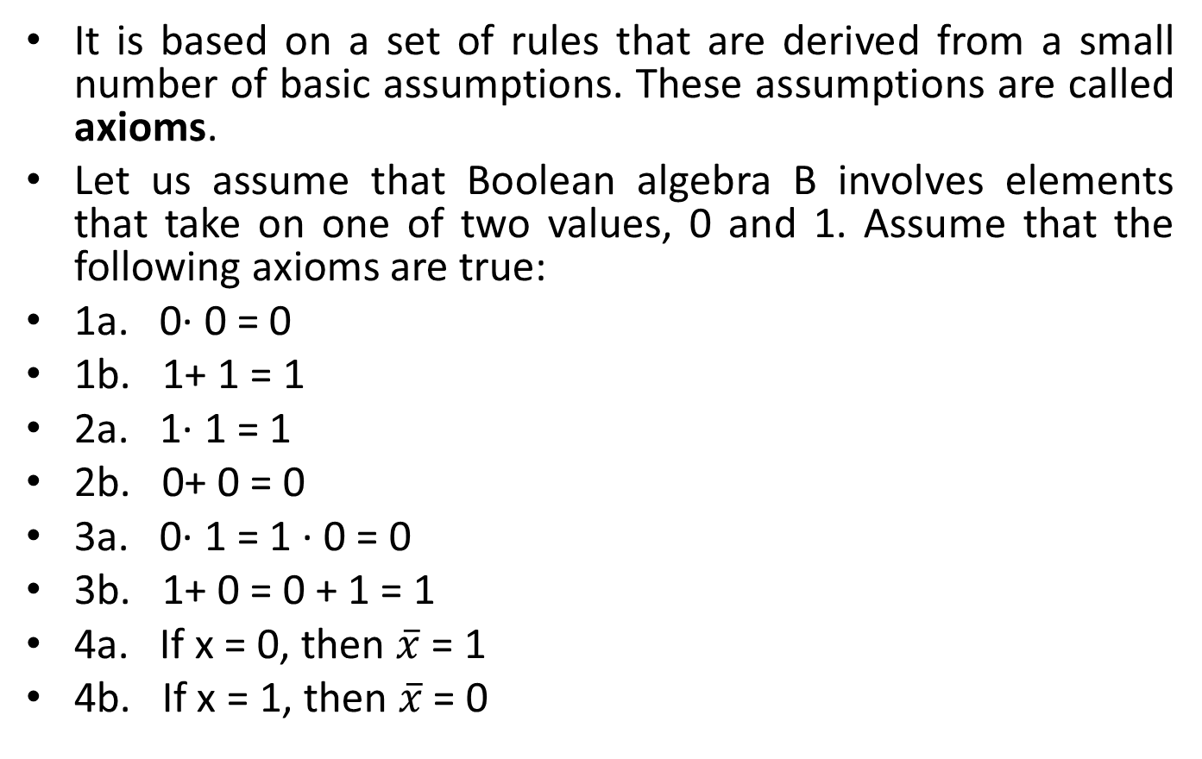
Axioms of Boolean Algebra
It is based on a set of rules that are derived from a small number of basic assumptions. These assumptions are called axioms.
Let us assume that Boolean algebra B involves elements that take on one of two values, 0 and 1. Assume that the following axioms are true:
1a. 0· 0 = 0
1b. 1+ 1 = 1
2a. 1· 1 = 1
2b. 0+ 0 = 0
3a. 0· 1 = 1 · 0 = 0
3b. 1+ 0 = 0 + 1 = 1
4a. If x = 0, then $\overline{x}$ = 1
4b. If x = 1, then $\overline{x}$ = 0

Slide 12
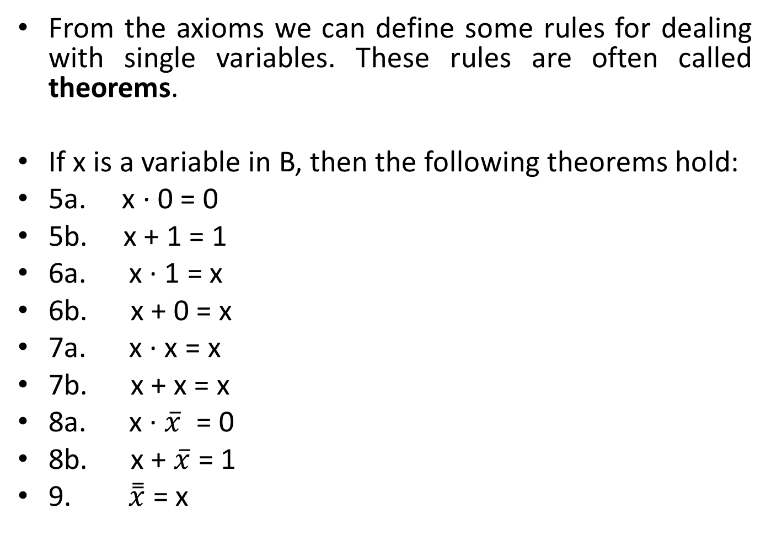
Single-Variable Theorems
From the axioms we can define some rules for dealing with single variables. These rules are often called theorems.
If x is a variable in B, then the following theorems hold:
5a. x · 0 = 0
5b. x + 1 = 1
6a. x · 1 = x
6b. x + 0 = x
7a. x · x = x
7b. x + x = x
8a. x · $\overline{x}$ = 0
8b. x + $\overline{x}$ = 1
9. $\overset{̿}{x}$ = x

Slide 13
Duality
Given a logic expression, its dual is obtained by replacing all + operators with · operators, and vice versa, and by replacing all 0s with 1s, and vice versa.

Slide 14
Two- and Three-Variable Properties
Two- and three-variable algebraic identities are often referred to as properties.
If x, y, and z are the variables in B, then the following properties hold:
10a. x · y = y · x Commutative
10b. x + y = y + x
11a. x · ( y · z) = (x · y) · z Associative
11b. x + ( y + z) = (x + y) + z

Slide 15
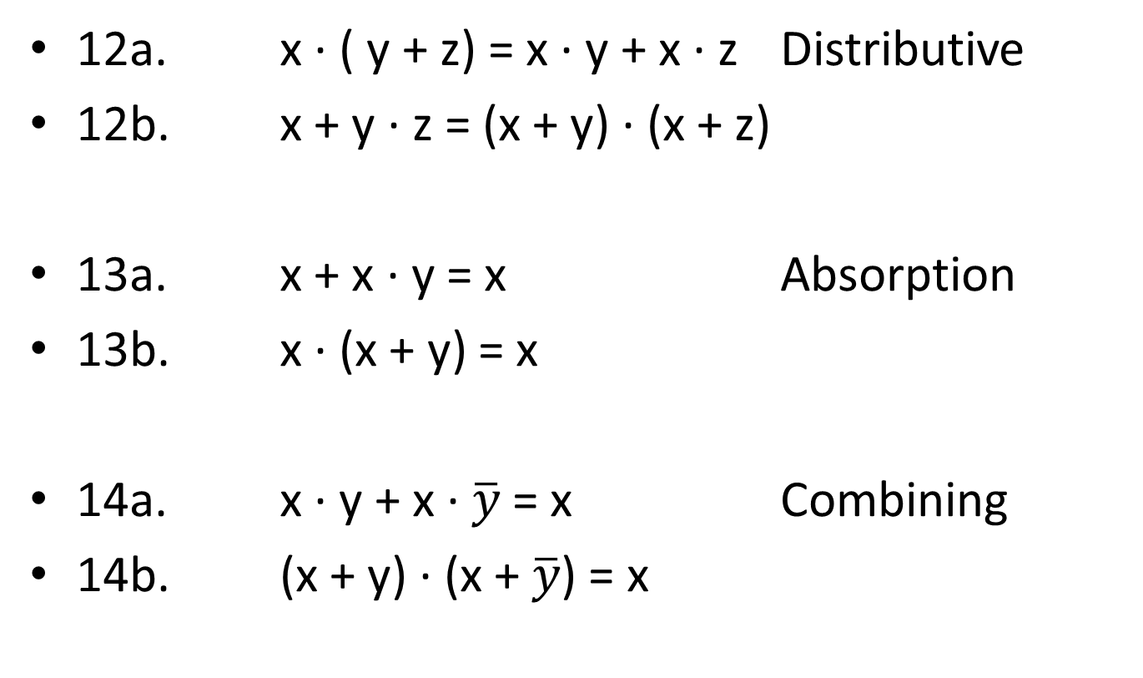
Two- and Three-Variable Properties
12a. x · ( y + z) = x · y + x · z Distributive
12b. x + y · z = (x + y) · (x + z)
13a. x + x · y = x Absorption
13b. x · (x + y) = x
14a. x · y + x · $\overline{y}$ = x Combining
14b. (x + y) · (x + $\overline{y}$) = x

Slide 16

Two- and Three-Variable Properties
DeMorgan’s theorem
15a. $\overline{x.y}$ = $\overline{x}$ + $\overline{y}$
15b. $\overline{x+y}$ = $\overline{x}$ . $\overline{y}$

Slide 17
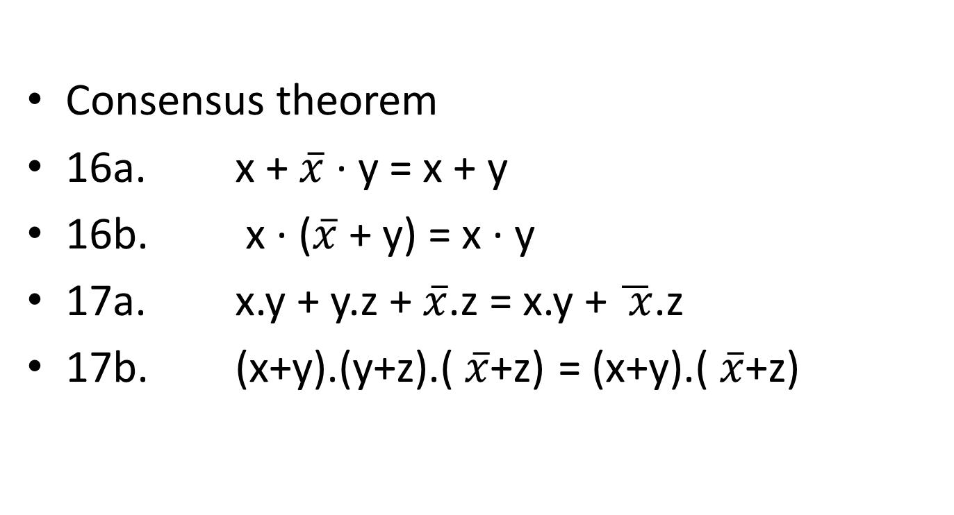
Two- and Three-Variable Properties
Consensus theorem
16a. x + $\overline{x}$ · y = x + y
16b. x · ($\overline{x}$ + y) = x · y
17a. x.y + y.z + $\overline{x}$.z = x.y + $\overline{ x}$.z
17b. (x+y).(y+z).($\overline{x}$+z) = (x+y).($\overline{x}$+z)

Slide 18
Synthesis using AND, OR and NOT gates
Create a product term that has a value of 1 for each valuation for which the output function f has to be 1.
Then we can take the logical sum of these product terms to realize f.
If input variable xi is 1 then xi is entered; if xi=0 then xi’ is entered.

Slide 19
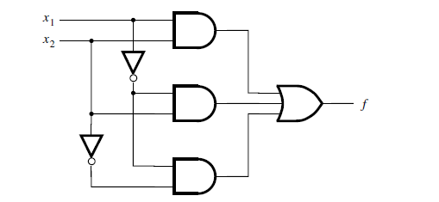
F(x1,x2) = X1X2+ X1’X2’+ X1’X2

Slide 20

F(X1,X2) = X2+ X1’

Slide 21
Minterms
For a function of n variables, a product term in which each of the n variables appears once is called a minterm.
The variables may appear in either uncomplemented or complemented form.
For a given row of the truth table, the minterm is formed by including xi if xi=1 and by including xi’ if xi=0.

Slide 22
Three Variable minterms & maxterms

Slide 23
Sum of products forms
Any function f can be represented by a sum of minterms that correspond to the rows in the truth table for which f=1.
A logic expression consisting of product terms that are summed is said to be sum-of-product form.
If each product term is a minterm, then the expression is called canonical sum-of-products for the function f.

Slide 24
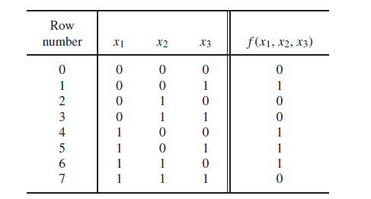
A Three variable function

Slide 25
Maxterms
The principle of duality suggests that if it is possible to synthesize a function f by considering the rows in the truth table for which f=1, then it should also be possible to synthesize f by considering the rows for which f=0.

Slide 26
Product-of-sum forms
A logic expression consisting of sum terms that are the factors of a logical product is said to be of the product-of-sums form.
If each sum term is a maxterm, then the expression is called a canonical-product-of sums for the given function.

Slide 27
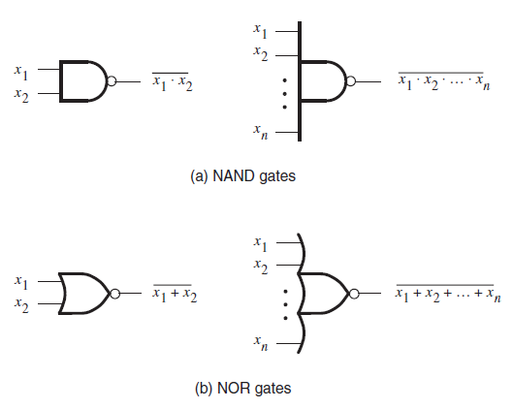
NAND & NOR Gates

Slide 28
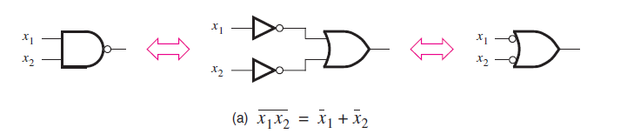
Demorgan’s theorem in terms of logic gates

Slide 29
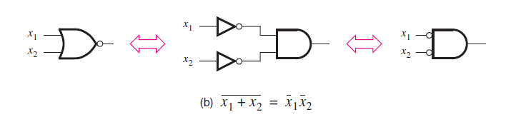
Demorgan’s theorem in terms of logic gates

Slide 30
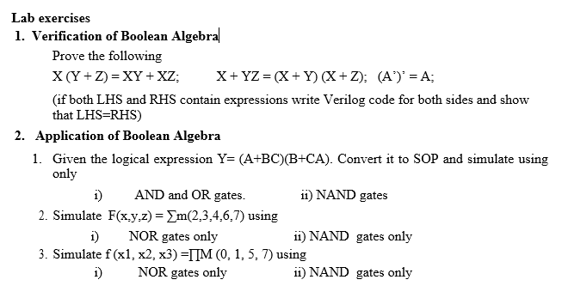
Lab-2 VERIFICATION AND APPLICATION OF BOOLEAN ALGEBRA

Slide 31
Introduction to Verilog
Introduction to CAD Tools
To design a logic circuit, a number of CAD tools are needed.
Usually packaged together into a CAD system, which typically includes tools for the following tasks: design entry, synthesis and optimization, simulation, and physical design.

Slide 32
Design Entry
The starting point in the process of designing a logic circuit is the conception of what the circuit is supposed to do and the formulation of its general structure.
The first stage of this process involves entering into the CAD system a description of the circuit being designed. This stage is called design entry.
For design entry we are writing source code in a hardware description language.

Slide 33
Hardware Description Languages
A hardware description language (HDL) is similar to a typical computer programming language except that an HDL is used to describe hardware rather than a program to be executed on a computer.
Two HDLs are IEEE standards: Verilog HDL and VHDL.

Slide 34
Why to use Verilog
Supported by most companies that offer digital hardware technology.
Verilog provides design portability. A circuit specified in Verilog can be implemented in different types of chips and with CAD tools provided by different companies, without having to change the Verilog specification.
Both small and large logic circuit designs can be efficiently represented in Verilog code.

Slide 35
Representation of Digital Circuits in Verilog
Structural representation- A larger circuit is defined by writing code that connects simple circuit elements together.
Behavioral representation- Describing a circuit by using logic expressions and programming constructs that define the behavior of the circuit but not its actual structure in terms of gates.

Slide 36
Structural Specification of Logic Circuits
A gate is represented by indicating its functional name, output, and inputs.
For example,
A two-input AND gate, with inputs x1 and x2 and output y, is denoted as
and (y, x1, x2);
A four-input OR gate is specified as
or (y, x1, x2, x3, x4);
The NOT gate given by not (y, x); implements y = x’.

Slide 37
Verilog Module
It is a circuit or sub circuit described with Verilog code.
The module has a name, module_name, which can be any valid identifier, followed by a list of ports.
The term port refers to an input or output connection in an electrical circuit. The ports can be of type input, output, or inout (bidirectional), and can be either scalar or vector.

Slide 38
Verilog Module
module module_name [(port name{, port name})];
[parameter declarations]
[input declarations]
[output declarations]
[inout declarations]
[wire or tri declarations]
[reg or integer declarations]
[function or task declarations]
[assign continuous assignments]
[initial block]
[always blocks]
[gate instantiations]
[module instantiations]
endmodule

Slide 39
Identifier Names
Identifiers are the names of variables and other elements in Verilog code.
The rules for specifying identifiers are simple: any letter or digit may be used, as well as the _ underscore and $ characters.
An identifier must not begin with a digit and it should not be a Verilog keyword.
Examples of legal identifiers are f, x1, x, y, and Byte.
Some examples of illegal names are 1x, +y, x*y, and 258
Verilog is case sensitive, hence k is not the same as K, and BYTE is not the same as Byte.
Verilog Operators
Verilog operators are useful for synthesizing logic circuits.

Slide 40
Documentation in Verilog Code
Documentation can be included in Verilog code by writing a comment.
A short comment begins with the double slash, //, and continues to the end of the line.
A long comment can span multiple lines and is contained inside the delimiters /* and */.

Slide 41
White Space
White space characters, such as SPACE and TAB, and blank lines are ignored by the Verilog compiler.
Multiple statements can be written on a single line.
Placing each statement on a separate line and using indentation within blocks of code, such as an if-else statement are good ways to increase the readability of code.

Slide 42
Running a sample Verilog code
Create a directory with section followed by roll number(to be unique); e.g. A21
Start →Programs Altera →MAX + plus II
The MAX + plus II manager window will pop up.
Select File from the menu bar, then select Project →Name and give project name. The project name will come on the title bar. This step is optional. If skipped, before compilation follow File →Project →Set Project to Current File.

Slide 43
Running a sample Verilog code
Then follow MAX + plus II →Text Editor. Text Editor is used to type the source code.
Save the source code with file name same as project name but with .v extension in the required directory.
Then follow MAX + plus II →Compiler. If step 2 is skipped, follow File →Project →Set Project to Current File first and then select Compiler. The compiler window will pop up.
Click Start. The source file will be compiled and errors if any will be displayed. Double click on the first error to rectify it. Rectify all the errors and recompile to get error free compiled file.

Slide 44
Simple logic function

Slide 45
Using gate level primitives
module example2(x1,x2,x3,f);
input x1,x2,x3;
output f;
and (g,x1,x2);
not (k,x2);
and (h,k,x3);
or (f,g,h);
endmodule

Slide 46
Running a sample Verilog code
Select MAX + plus II →Waveform Editor . The Waveform Editor window will pop up.
Then select Node →Enter Nodes from SNF (simulator netlist file)and then in the popped up box click List button to display the names of input and output nodes in the box labeled Available Nodes & Groups.
Select the nodes if not selected, and click => button to copy them into Selected Nodes & Groups box. Click OK to return to waveform editor. The nodes are now displayed in waveform display.

Slide 47
Running a sample Verilog code
Now the values to the inputs will be given. Select File →End Time to specify the total amount of time for simulation. If not specified it will take default time.
Select View →Fit in Window so that entire time range is visible in the waveform editor display. Select Options →Grid Size to give appropriate grid size.
Either the single value or different values at different grids can be given to the input signals. To give single value select the entire signal and click the required value which is activated in the left side of the window. To give different values select a section of the signal by dragging the mouse over it and then by clicking the required value. After giving the values save the file with same name as before but with .scf (simulator channel file) extension.

Slide 48
Running a sample Verilog code
Select MAX + plus II →Simulator. Click Start. A message box will be displayed indicating no errors. Click OK. And then Open SCF to view the waveforms after simulation.

Slide 49
Behavioral Specification of Logic Circuits
Gate level primitives can be tedious when large circuits have to be designed.
To use more abstract expressions and programming constructs to describe the behavior of a digital circuit.
To define the circuit using logic expressions. The AND and OR operations are indicated by the “&” and “|” signs, respectively.
The assign keyword provides a continuous assignment for the output signal.
Whenever any signal on the right-hand side changes its state, the value of output will be re-evaluated.

Slide 50
Behavioral Specification of Logic Circuits
module example2 (x1, x2, x3, f);
input x1, x2, x3;
output f;
assign f = (x1 & x2) | ( x2 & x3);
endmodule

